Slide 1

MYTHOLOGICA
A Prolog-Based Mythological, Religious & Folklore Knowledge System.
Presented by: Mazharul Islam Sourav

Slide 2
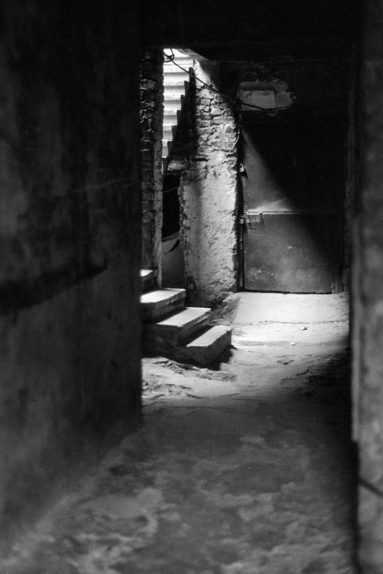
PROBLEM
STATEMENT
– There is a lack of efficient, centralized resources to explore religious, mythological, and folklore stories in one place.
Many supernatural beings from religious, mythological, and folklore traditions are described across diverse cultures and texts, but there is no unified system to represent and analyze their complex relationships and characteristics. This project builds a centralized Prolog knowledge base that organizes these entities with cultural context, types, and domains, enabling logical querying and inference about their interactions and attributes in one place.

Slide 3
BACKGROUND
Mythological
Folklore
Religious
Mythological stories are ancient tales about gods, heroes, and supernatural events. They explain how the world was created and teach lessons about life and nature.
Folklore stories are passed down in communities and often involve spirits, monsters, and magic. These tales reflect local traditions and teach morals.
Religious stories focus on gods, angels, and miracles. They guide people’s beliefs and show the connection between humans and the divine.

Slide 4


OBJECTIVE
The objective of this project is to create a centralized knowledge base using Prolog that organizes supernatural beings from mythology, folklore, and religion. This system enables efficient representation, querying, and logical reasoning about their cultural origins, relationships, domains, and attributes, providing users with a unified platform to explore and analyze these complex entities.

Slide 5
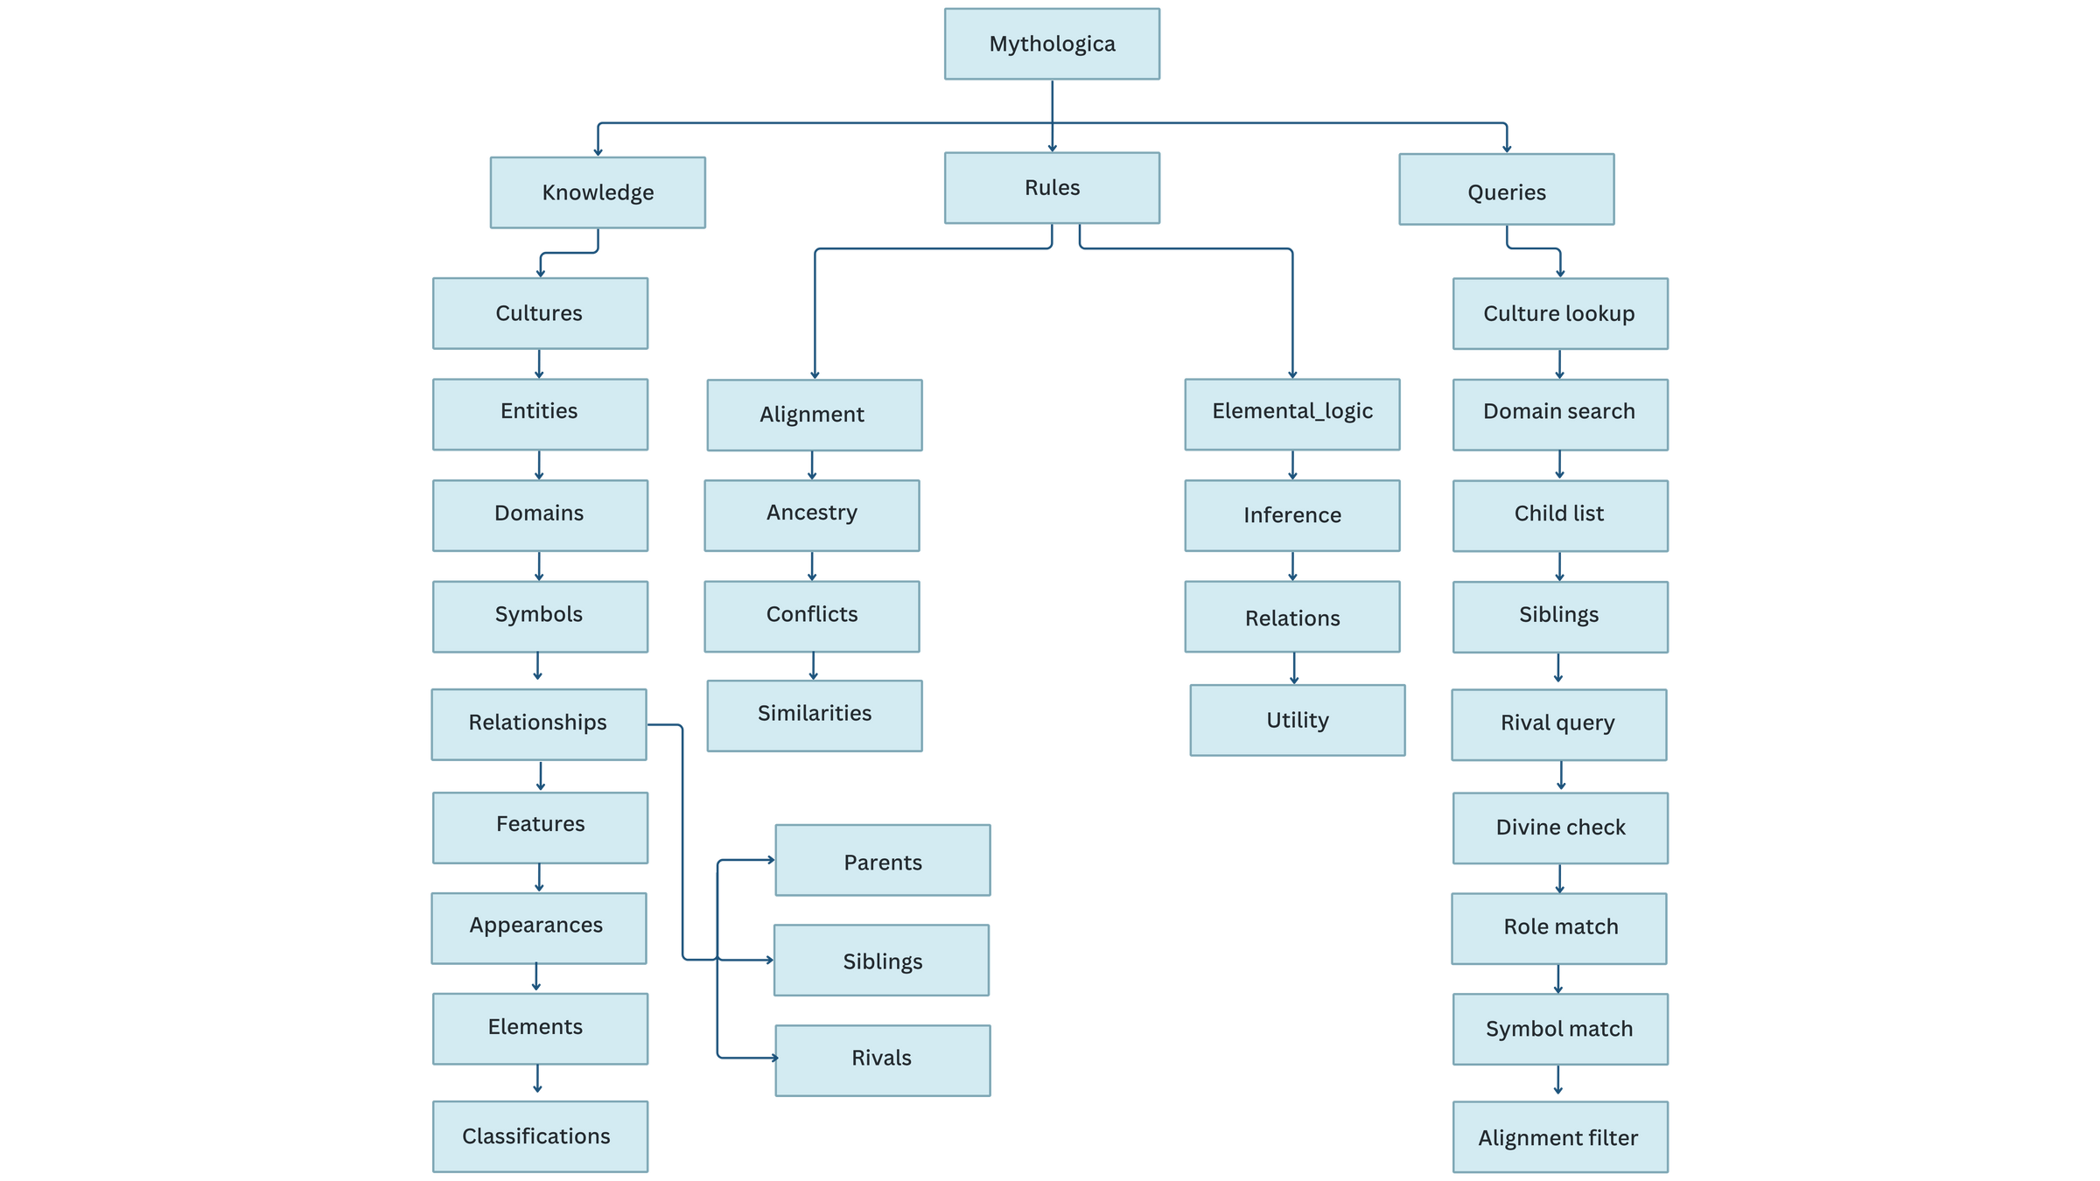
DIAGRAM
This diagram, created using Canva and draw.io, shows the relationships and classifications of supernatural beings in the knowledge base.

Slide 6



TOOLS USED
SWI-Prolog
Visual Studio Code
Canva
Prolog programming environment
Code Editor
Design and presentation

Slide 7
KEY FEATURES
Categorization by Origin
The knowledge base classifies beings based on their cultural origin (e.g., Greek, Norse, Islamic, Hindu).
Domain and Role Associations
The system stores what domains the beings are associated with, such as thunder, war, or wisdom.
Type Identification
Each entity is identified as a god, spirit, demon, etc.
Relationship Mapping
Logical relationships like "father of," "servant of," or "enemy of" are modeled to show mythological connections.
Expandable Structure
Easy to add new beings or rules without altering the existing structure
Interactive Queries
Users can ask meaningful questions like
[ ?- supernatural(jinn).]

Slide 8
TECHNICAL
REPORT
Report Link
Github: Technical Report
This technical report explains how the project was built using Prolog to organize information about supernatural beings from religious, folklore, and mythological sources. It includes the tools used like SWI-Prolog and draw.io, how the data was structured, and how relationships were shown through logic rules. The report also highlights some challenges faced during the design, shows sample queries, and explains how the knowledge base was made to give clear and useful answers.

Slide 9
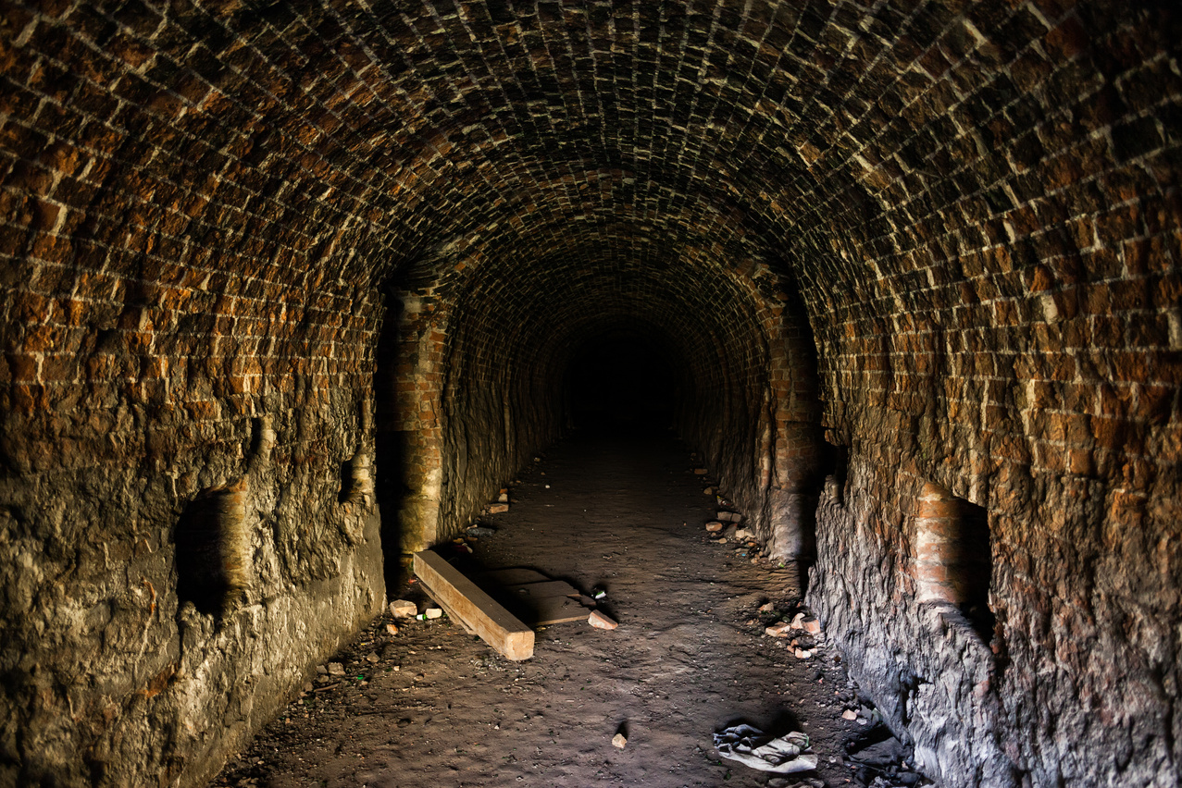
SOURCE CODE
The project’s source code consists of a structured Prolog knowledge base, including numerous facts and logical rules representing supernatural beings from religious, folklore, and mythological origins. With over 450+ lines of well-documented code, displaying everything here would be impractical. Instead, the entire codebase has been organized and uploaded to GitHub for easier viewing, sharing, and future collaboration.
🔗 GitHub Repository: Code

Slide 10
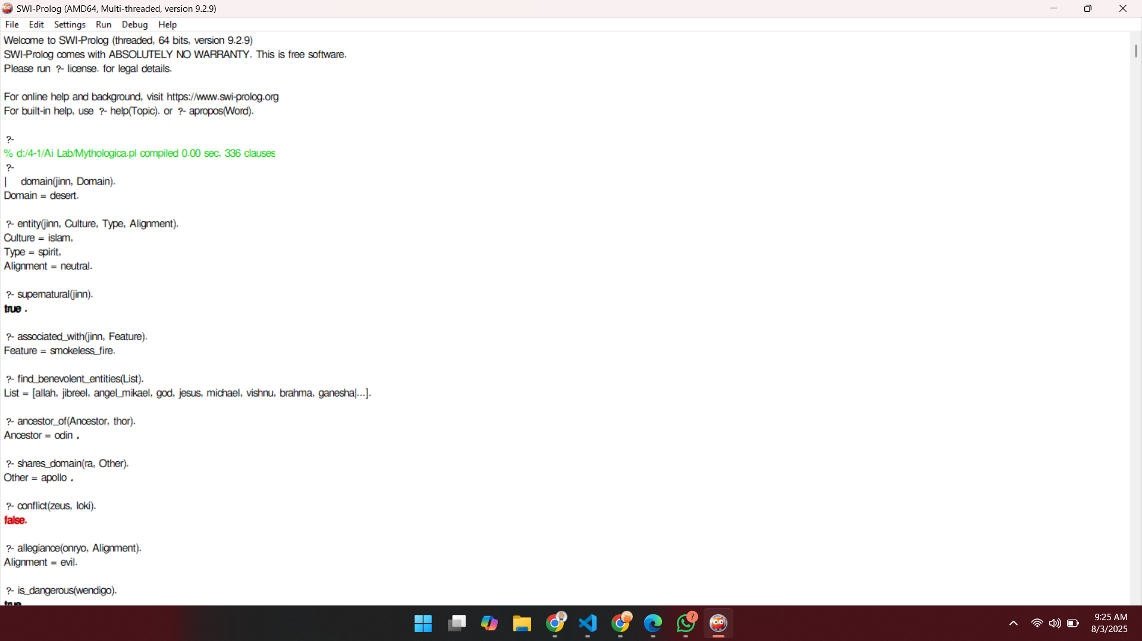
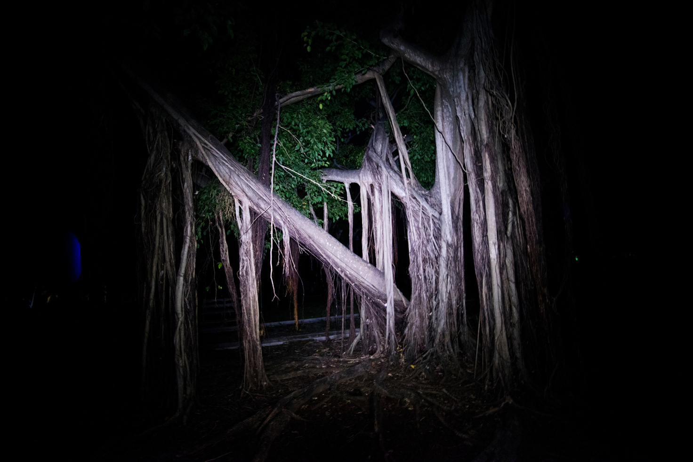
SAMPLE OUTPUT
Below are some example queries and their outputs, showcasing how the system responds to user input by retrieving relevant supernatural beings from the knowledge base.

Slide 11

CON
CLU
SION
This project solves the issue of not having a central place to explore supernatural beings from religious, folklore, and mythological stories. Built using Prolog, it creates a logical structure where users can search and discover meaningful connections. Though it's simple, it lays the groundwork for future development.
Key Takeaways:
Organized diverse supernatural knowledge into one query-based system
Built meaningful relationships using facts and rules in Prolog
Simple UI through logical queries for easy interaction
Can be improved further with more content, visuals, or a web interface
This project not only addresses the need for an organized supernatural knowledgebase but also highlights the power of logic programming in cultural studies. I hope it inspires further exploration and appreciation of the rich tapestry of mythology, religion, and folklore from around the world.

Slide 12

THANK YOU !
Thank You for Hearing
“Mythologica”
Your time and interest are truly appreciated.
Feel free to ask any questions or share your thoughts!

